Slide 1
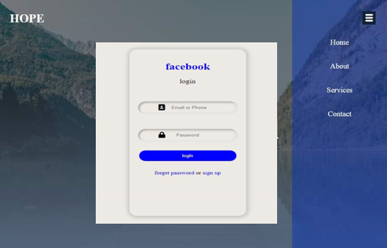
Task 2
Using only HTML and CSS do the following task

